Slide 1
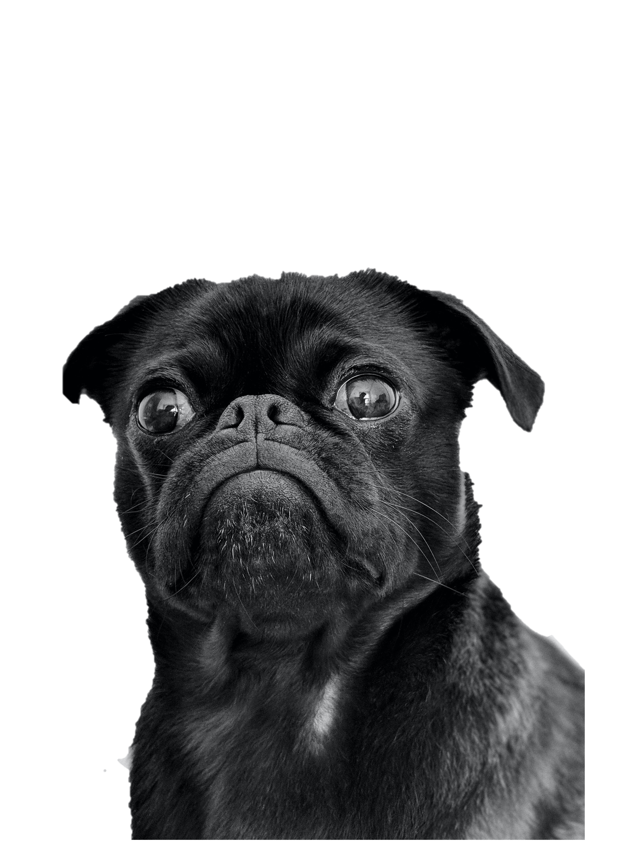
LAS 6292: Data Collection & Management
Emilio M. Bruna
University of Florida
Metadata

Slide 2



Our memory is
unreliable.
+
Over time we forget details.
Including our research.
About everything.

Slide 3
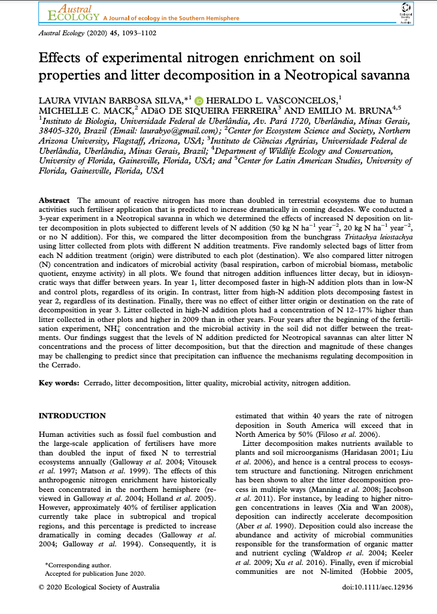

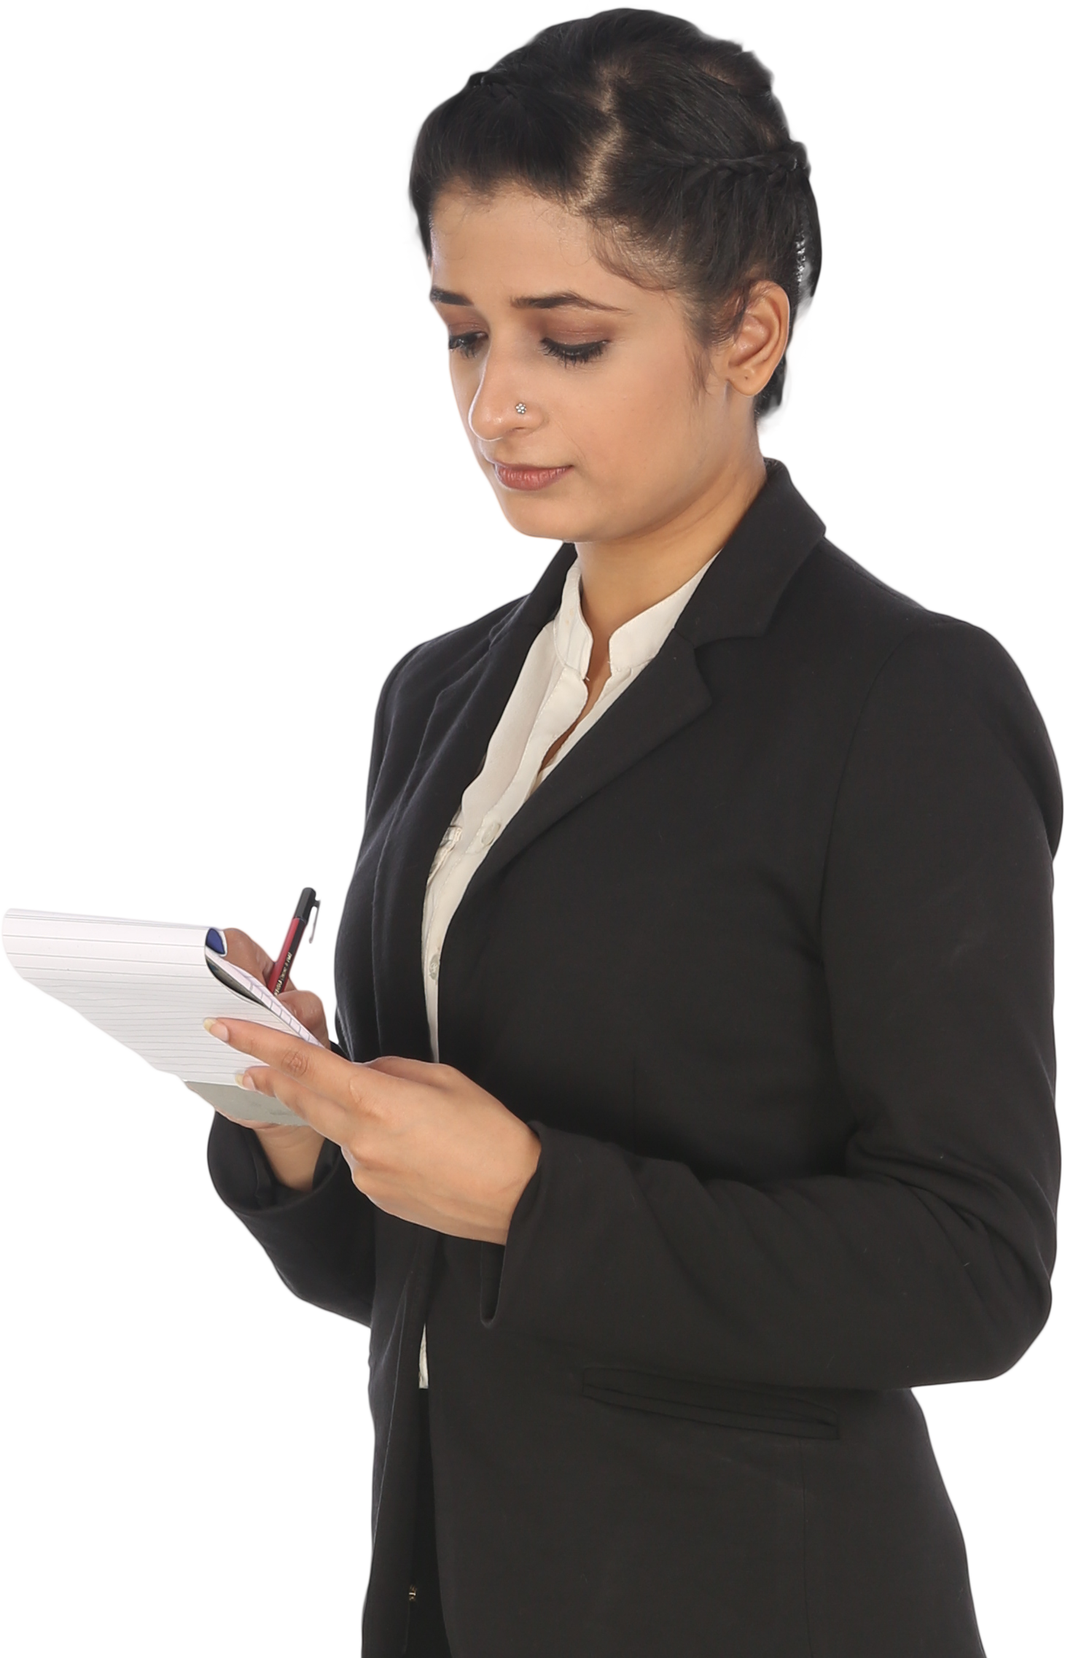
tik
People
Places
Names
Abbreviations
Subject Selection
Reagents
Equipment
Study design
Sampling
Coding
Identifications
Calculations
Analyses
tok

Slide 4
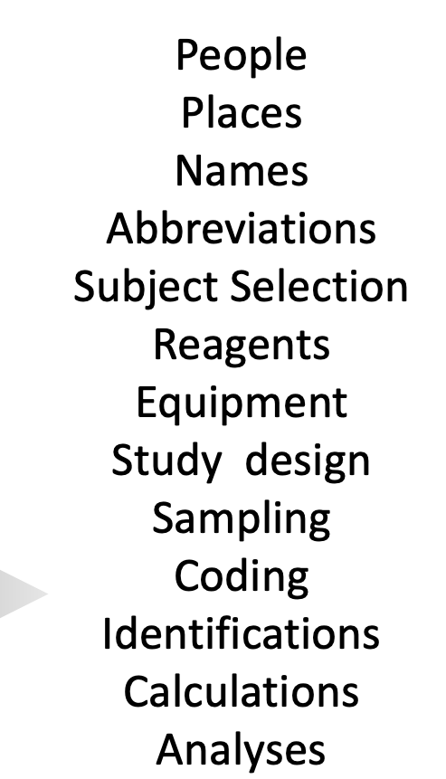
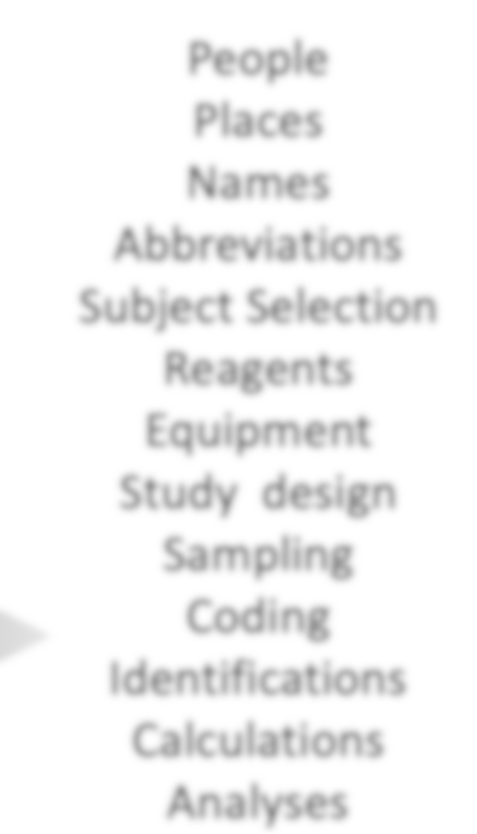
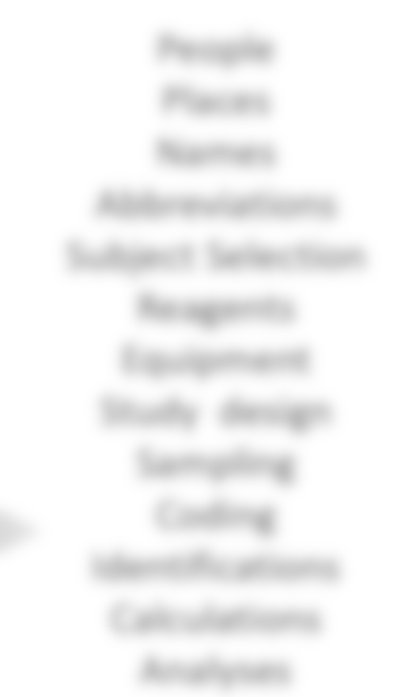
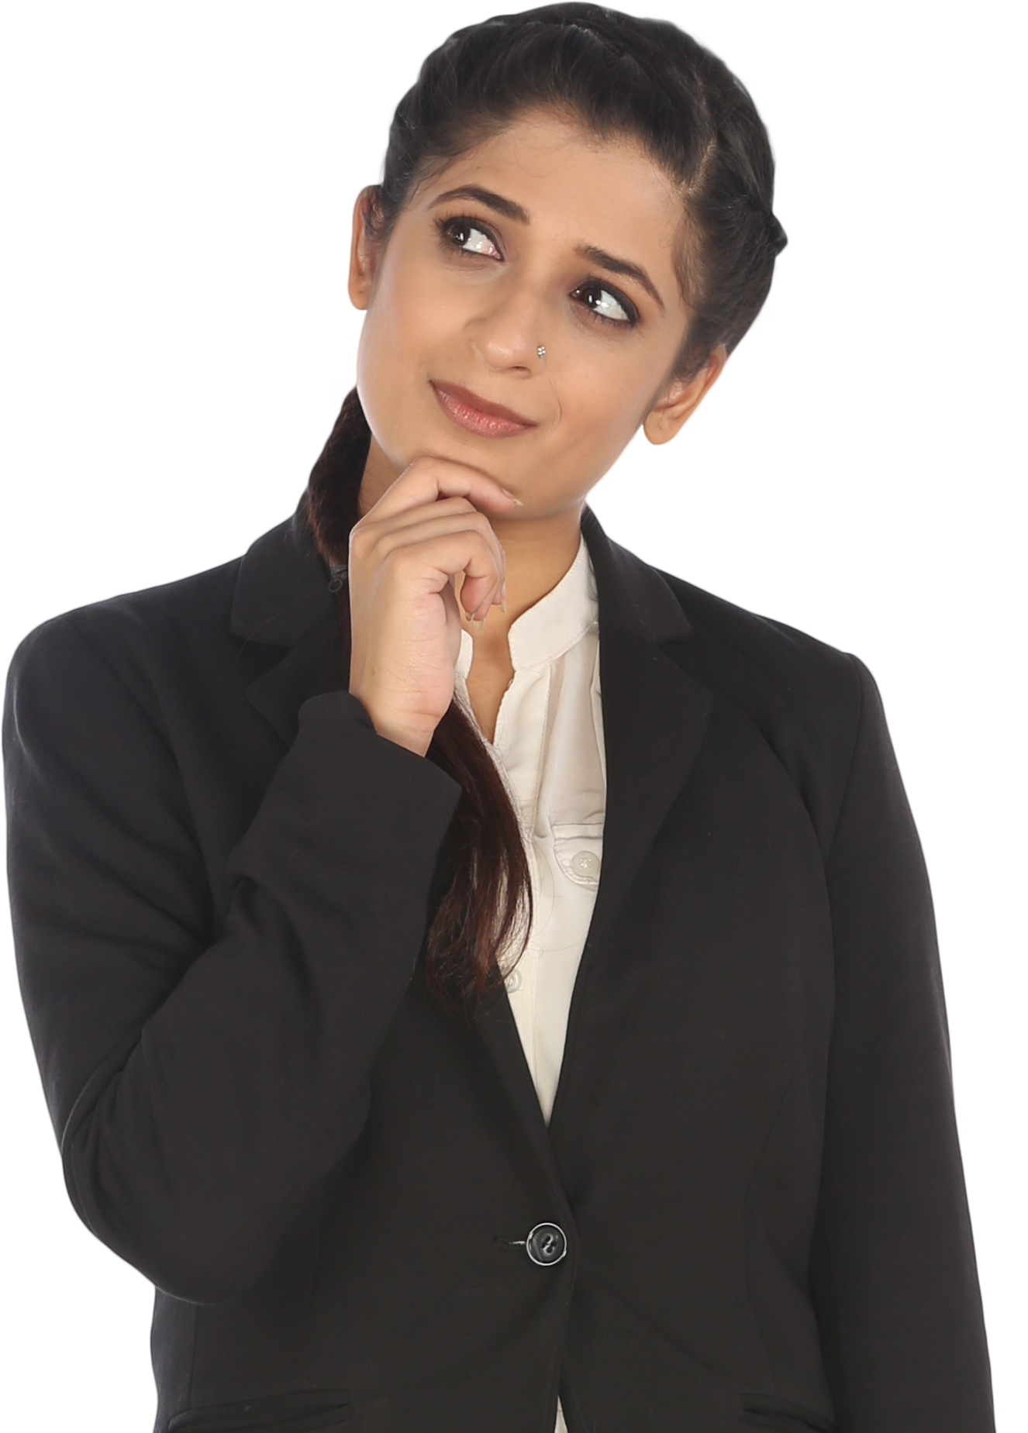

Slide 5
tik
tok

Slide 6
tik
tok

Slide 7

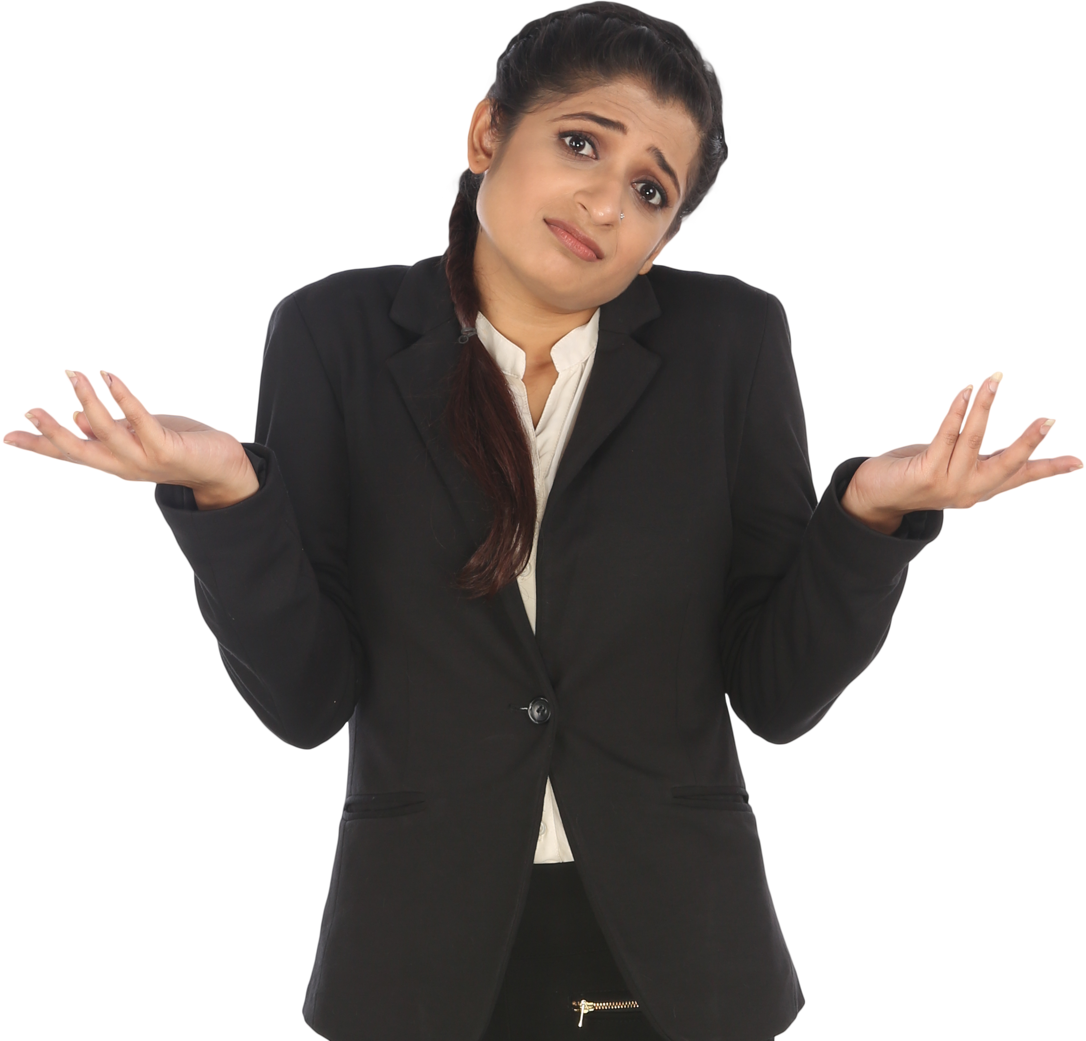

Slide 8
We refer to this as….

Slide 9
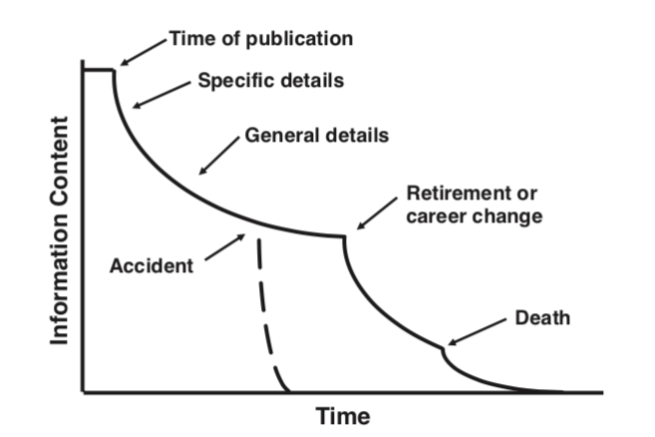
…the temporal loss of
“Information Entropy”
Information Entropy (IE): the information content associated with an event
IE is highest while we are working on a project…
…and declines quickly as we move on to new things...
…until it is eventually lost completely.
Fig 1 in Michener et al. 1997
Notes:
`

Slide 10
Put another way…

Slide 11
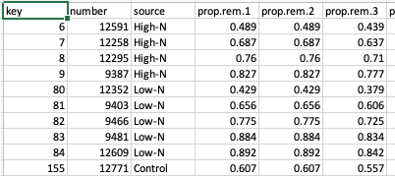
Imagine if someone wanted to reuse the data from our 2020 paper
published in Austral Ecology and I sent them this file...
Their first question would probably be:
“uhhhh….
what do these abbreviations mean?”
Notes:
`

Slide 12
Depending on how long ago the study was conducted,
the responses might be….

Slide 13
“This is what the abbreviations mean.”
“I need to double-check what the abbreviations mean.”
“I can guess what the abbreviations mean.”
“I don’t remember or care what the abbreviations mean.”
“He was such a wonderful person. If only we had taken the time to ask him what the abbreviations mean.”

Slide 14
Without these details about your research design & results,
People
Places
Names
Abbreviations
Subject Selection
Reagents
Equipment
Study design
Sampling
Coding
Identifications
Calculations
Analyses
your data can’t be re-used by others.

Slide 15
Without these details about your research design & results,
your data can’t be re-used by others.
Or even by you.

Slide 16
This vital information is called…

Slide 17
metadata
(Data about your Data)

Slide 18






WHY
were the data collected?
HOW
were the data collected?
WHEN
were they collected?
WHO
collected the data?
WHERE
were the data collected?
WHAT
is the content of the data?

Slide 19
You’ve seen metadata before…
…attached to pictures taken with cell phones…

Slide 20
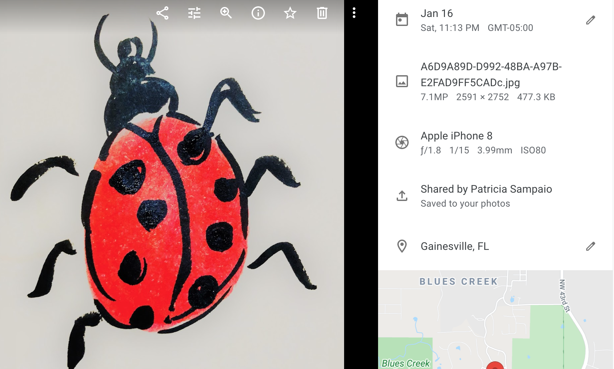
DATA
(the photo)
METADATA
when
what
how
who
where

Slide 21
When reading a book…

Slide 22
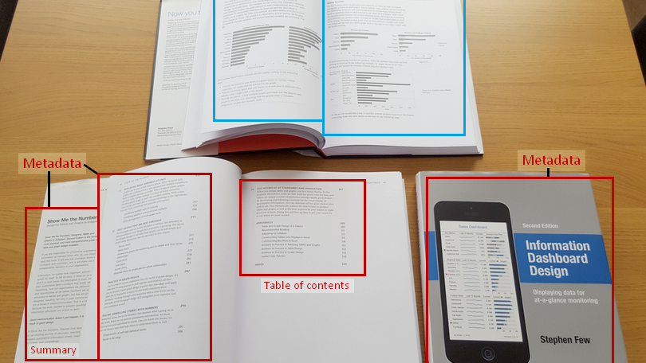
Data
information in text, tables, figures
Metadata
title, author edition
table of contents
summary
Modified from https://dataedo.com/kb/data-glossary/what-is-metadata

Slide 23
…or when shopping online.

Slide 24
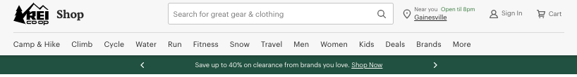
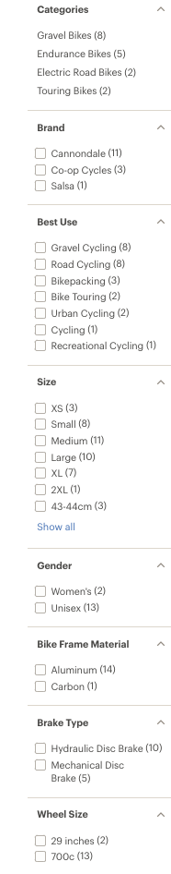
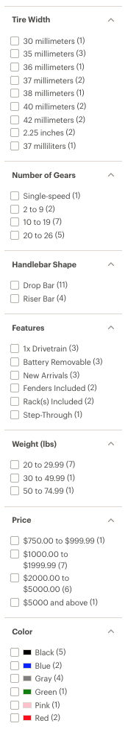
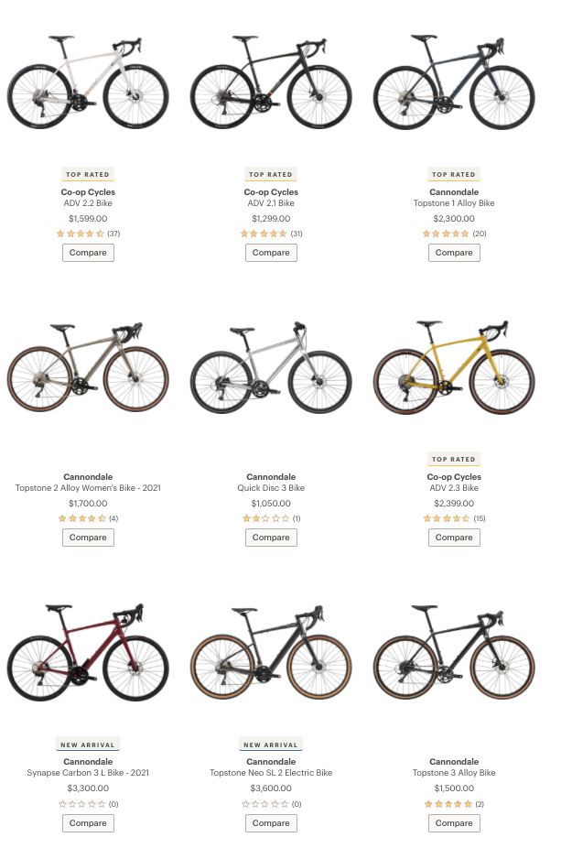
Metadata
Data

Slide 25
Remember…

Slide 26
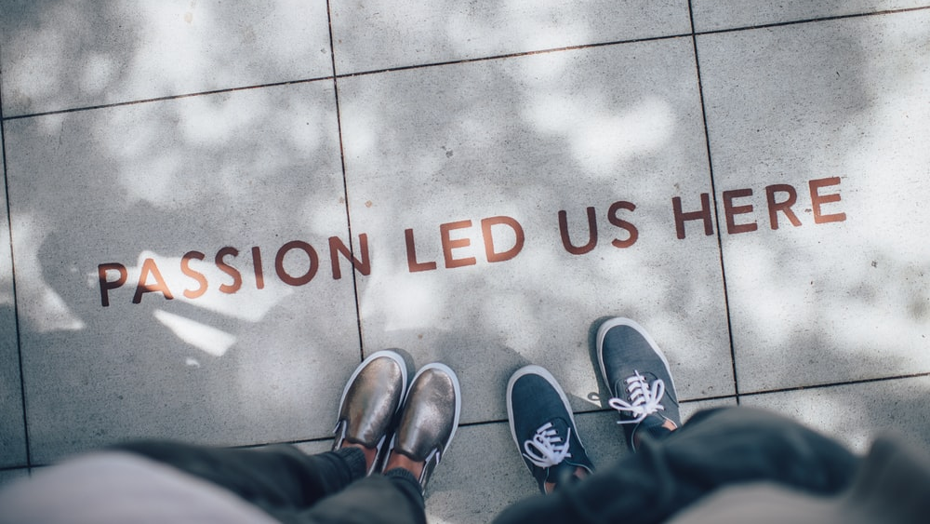
Notes:
Metadata is a declaration of
Purpose: the originator’s intended application of the data Use Constraints: inappropriate applications of the data Completeness: features or geographies excluded from the data
Distribution Liabilityexplicit liability of the data producer and assumed liability of the consumer

Slide 27
Metadata is a way to share that passion with other scholars.
(along with any constraints & liabilities of which they should be aware).

Slide 28
Doing this requires some basic
“metadata descriptors”
Class I
Class II
Alert potential secondary users to the existence of data sets falling within specific temporal, spatial, and thematic domains.
Describe the research resulting in a data set, including who conducted and funded the work.
Class III
Class IV
Status of the data set & information on its accessibility.
All attributes related to the structure of the data file.
Class V
Any other information that might be necessary for secondary usage or auditing of the data set.
Michener et al. 1997

Slide 29

What is the value of Metadata?
Notes:
Researchers & other Data Creators?
Avoid data duplication
Share reliable information
Publicize efforts & promote the work of a scientist
Efficiency: saves time and resources

Slide 30

Value to
Researchers:
Ability to reuse other’s data saves time, resources, & effort.
Increases chances one’s data will be found and re-used by others.
Re-use by others promotes & increases the impact of one’s work.

Slide 31

Value to
Data (re)Users:
Ability to search for, find, retrieve, & determine utility of datasets.
Determine if data exists about a geographic location or topic.
Learn how to acquire, process, & use datasets.
Understand the dataset & how the data were collected.

Slide 32
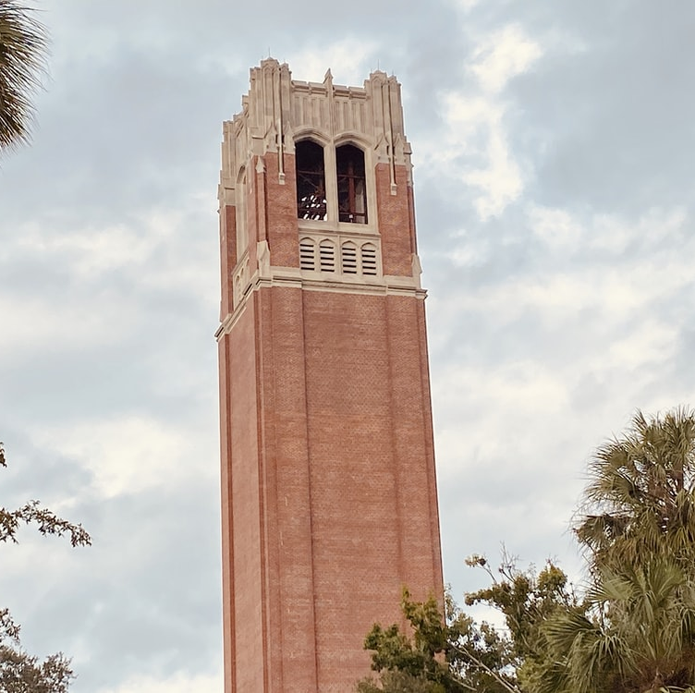
Value to
Organizations:
Documentation of research integrity: (e.g., steps taken to ensure quality control, data limitations, use restrictions).
Ensures other (& future) researchers at the institution can use the data.
Tracking use allows the institution to assess its impact.
Advertises organization’s research; mechanism for promoting new partnerships & collaborations.

Slide 33
But keep in mind…

Slide 34
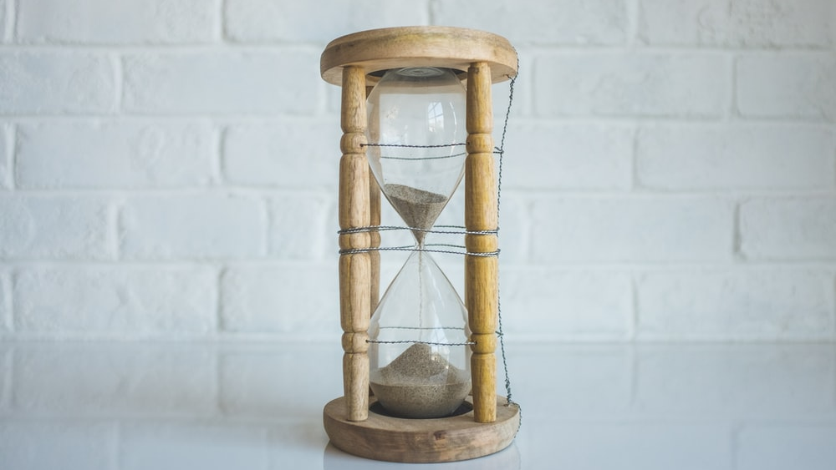
GOOD
METADATA
TAKES
TIME
You start working on metadata before collecting data.

Slide 35

PLAN AHEAD
Find and use
the metadata standards for
your discipline.
Notes:
Concerns About Creating Metadata
Concern Solution
Workload required to capture accurate robust metadata
Incorporate metadata creation into data development process – distribute the effort
Time and resources to create, manage, and maintain metadata
Include in grant budget and schedule
Readability / usability of metadata Use a standardized metadata format
Discipline specific information and ontologies Use a standard ‘profile’ that supports discipline specific information

Slide 36

INVEST EFFORT
Keep good records.
Review for accuracy & completeness; get feedback.
Work more efficiently & ensure machine readability by using a metadata platform.
Update as needed.
Notes:
1. Organize your information Did you write a project abstract to obtain funding for your proposal? Reuse it in your metadata! Did you use a lab notebook or other notes during the data development process that define measurements and other parameters? Do you have the contact information for colleagues you worked with? What about citations for other data sources you used in your project? 2. Write your metadata using a metadata tool 3. Review for accuracy and completeness 4. Have someone else read your record 5. Revise the record, based on comments from your reviewer 6. Review once more before you publish

Slide 37
But most important,
remember why we are going to all this effort:

Slide 38
Notes:
Metadata is a declaration of
Purpose: the originator’s intended application of the data Use Constraints: inappropriate applications of the data Completeness: features or geographies excluded from the data
Distribution Liabilityexplicit liability of the data producer and assumed liability of the consumer

Slide 39



+
=
&
Music:
www.bensound.com
Sources:
Michener, W. K., Brunt, J. W., Helly, J. J., Kirchner, T. B., & Stafford, S. G. (1997). Nongeospatial metadata for the ecological sciences. Ecological Applications, 7(1), 330-342.
DataONE Community Engagement & Outreach Working Group (2017) "Metadata Management". Accessed through the Data Management Skillbuilding Hub at https://dataoneorg.github.io/Education/lessons/07_metadata/index

Slide 41

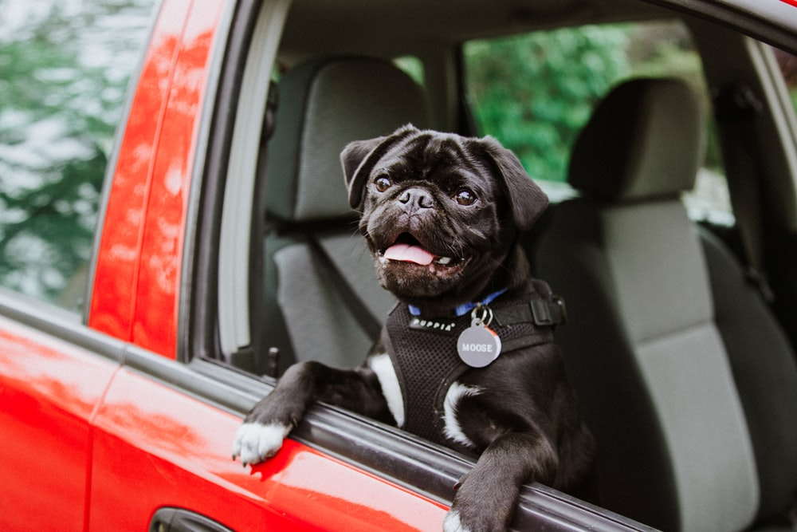

Slide 42
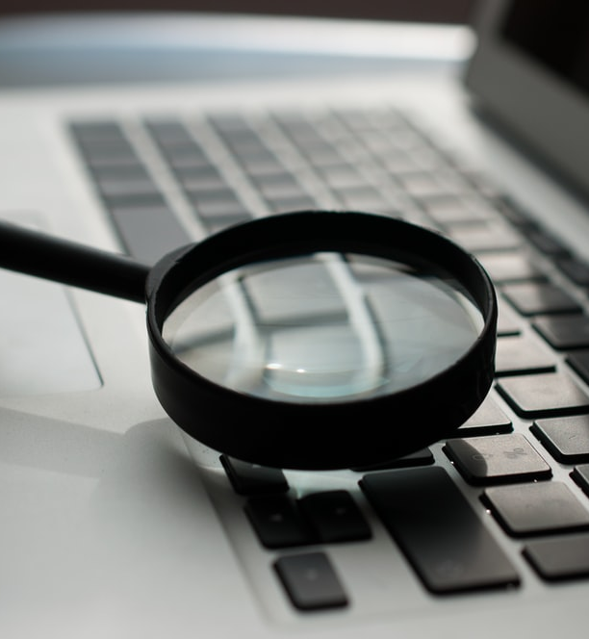
MAKE YOUR DATA F.A.I.R.
Findable
Accessible
Interoperable
Re-Usable

Slide 43
MAKE YOUR DATA F.A.I.R.
Findable
Persistent identifiers, data repositories

Slide 44
MAKE YOUR DATA F.A.I.R.
Accessible
Readable by machines and humans

Slide 45
MAKE YOUR DATA F.A.I.R.
Interoperable
Shared vocabularies / ontologies

Slide 46
MAKE YOUR DATA F.A.I.R.
Re-Usable
Metadata that allow others to reuse your data and link it with other data sources

